Slide 1

Computers Principles
Introduction of Computers
Civil Engineering Department
College of Engineering / Diyala University/ 2017-2018.
Dr. Qasim Adnan Aljanabi

Slide 2
تقييم درجة الطالب
1- يتم اعطاء المحاضرة مع واجب بيتي يتم تقديمها في المحاضرة التي تليها.
2-الحضور يتم اعطاء نسبة من الدرجة والتقييم.
3- الامتحان مفاجئ: يكون في كل محاضرة وبدون تحديد الموعد والوقت.
4- الامتحان الفصلي: امتحان واحد او اثنين.
5- المشاريع التي يكلف فيها الطالب.

Slide 3
What is Computer?
Computer is a machine that performs tasks or calculations according to a set of instructions, or programs.
The first fully electronic computers, introduced in the 1940s, were huge machines that required teams of people to operate.
Computers work through an interaction of hardware and software.
Hardware refers to the parts of a computer that you can see and touch, including the case and everything inside it. Hardware items such as your monitor, keyboard, mouse, printer, and other components are often called hardware devices, or devices.
Software refers to the instructions, or programs, that tell the hardware what to do. A word-processing program that you can use to write letters on your computer is a type of software.

Slide 4
What can do with computers?
In the workplace, many people use computers to keep records, analyze data, do research, and manage projects.
At home, you can use computers to find information, store pictures and music, play games, and communicate with others—and those are just a few of the possibilities.
You can also use your computer to connect to the Internet, a network that links computers around the world. Here are some of the most popular things to do with computers: the web, E-mail, Instant messaging, Pictures, music, movies, and gaming.

Slide 5
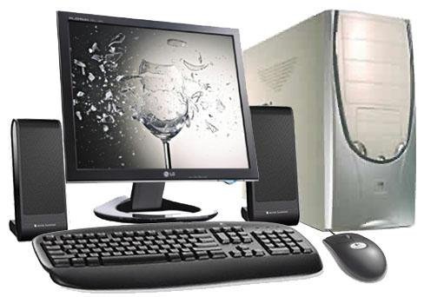
Types of Computers
1- Desktop computers
Desktop computers are designed for use at a desk or table.
They are typically larger and more powerful than other types of personal computers.
Desktop computers are made up of separate components, called the system unit, the monitor, mouse, and keyboard, connect to the system unit.
2- Laptop computers and small notebook
Laptop computers are lightweight mobile PCs with a thin screen. Laptops can operate on batteries, so you can take them anywhere. The screen folds down onto the keyboard when not in use.
Small notebook PCs are small, affordable laptops that are designed to perform a limited number of tasks. They're usually less powerful than a laptop, so they're used mainly to browse the web and check e-mail.

Slide 6
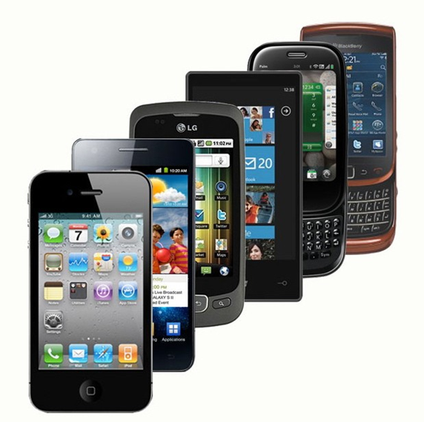
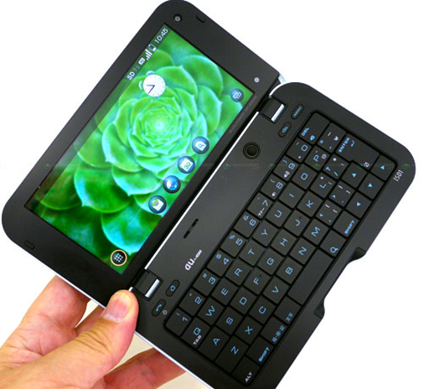
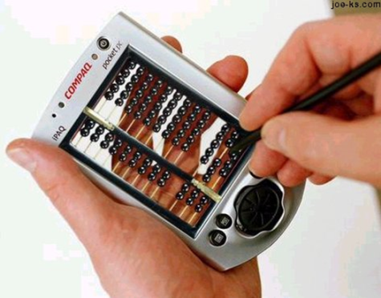
3- Smart phones
Smart phones are mobile phones that have some of the same capabilities as a computer.
You can use a smart phone to make telephone calls, access the Internet, organize contact information, send e-mail and text messages, play games, and take pictures.
Smart phones usually have a keyboard and a large screen.
4- Handheld computers
Handheld computers, also called personal digital assistants (PDAs), are battery-powered computers small enough to carry almost anywhere.
Handheld computers are useful for scheduling appointments, storing addresses and phone numbers, and playing games.
Instead of keyboards, handheld computers have touch screens that you use with your finger or a stylus (a pen-shaped pointing tool).

Slide 7
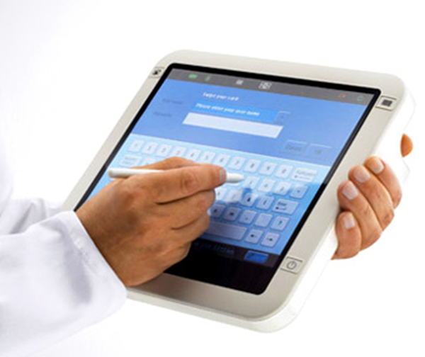
5- Tablet PCs
Tablet PCs are mobile PCs that combine features of laptops and handheld computers.
Like laptops, they're powerful and have a built-in screen.
Like handheld computers, they allow you to write notes or draw pictures on the screen, usually with a tablet pen (the pen that come with table and is used to interact with items in the screen).

Slide 8
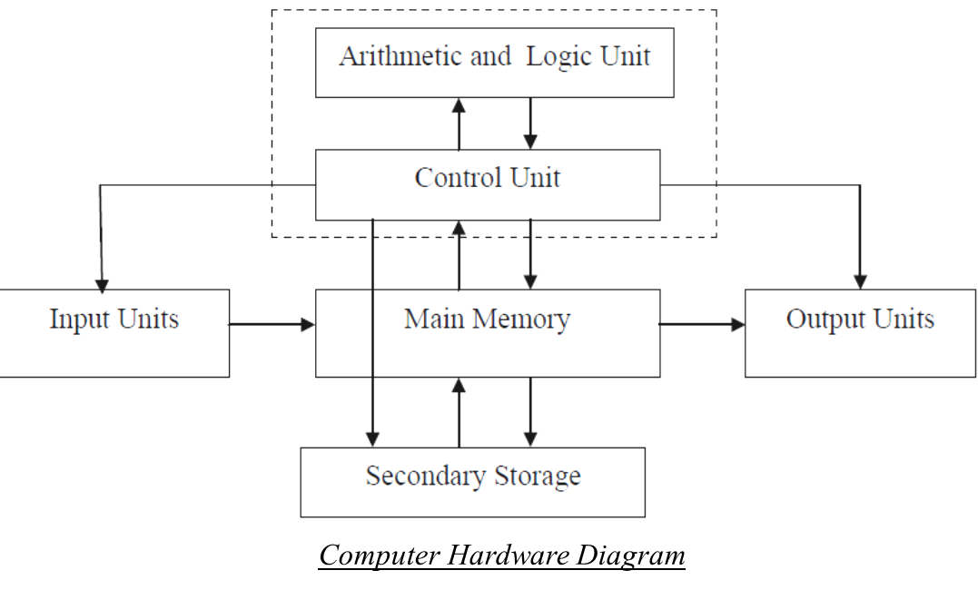
Computers Operations
Input data and instruction by input unit.
Save and process data and instruction by memory unit and central processing unit.
Output results and instruction by output unit.

Slide 9

Questions - ?

